Slide 1
Recycled
PET Extruder
Team Bonfire: Blake, Sam, Melanie, and Amy

Slide 2
Major Goals & Deliverables
01
02
03
Preliminary Material Testing
Perform tests on pellets and regrind to determine processing parameters
Simulation and Design
Simulate screw design from parameters and design extruder in CAD
Creating, Printing, and Testing
Extrude filament, print it on a 3D printer, and perform tests for mechanical strengths

Slide 3
Preliminary Material Testing
Allotted Time: January - early February (1 month)
Action Items:
Acquire plastic bottles
Ideally from Vanderbilt Recycling center
Circular plastics economy
Test current extruder in Digital Fabrication Lab (Filabot EX6 Extruder Setup)
PLA
Test PET pellets using DSC & MFI
Fresh PET pellets
Pelletized 100% regrind PET filament
Notes:
-DSC: Differential Scanning Calorimeter – melting point, crystallization point – can determine printing temperature (space between the two curves) – when recycle material curves get wider and space gets smaller ie. printing temperature is smaller (someone’s lab here)
-MFI: Melt Flow Index – power law data for nextrucad → viscosity

Slide 4
Simulation and Design
Goal Date: January - mid February (1.5 months)
Actions Items:
Simulation and NextruCAD modeling
Key dimensions: screw diameter & diameter (L/D ratio), barrel wall thickness, etc.
Design filament extruder in Fusion 360
Simulate flow of plastic through extruder
Use generative design
Perform other simulations to determine needed strengths/temperature resistances
Order custom extruder screw and barrel
Have company custom mill to our specified sizes
Decide models of parts to buy
Assemble prototype extruder
Notes:
-need to figure out which company we want to get screw from

Slide 5
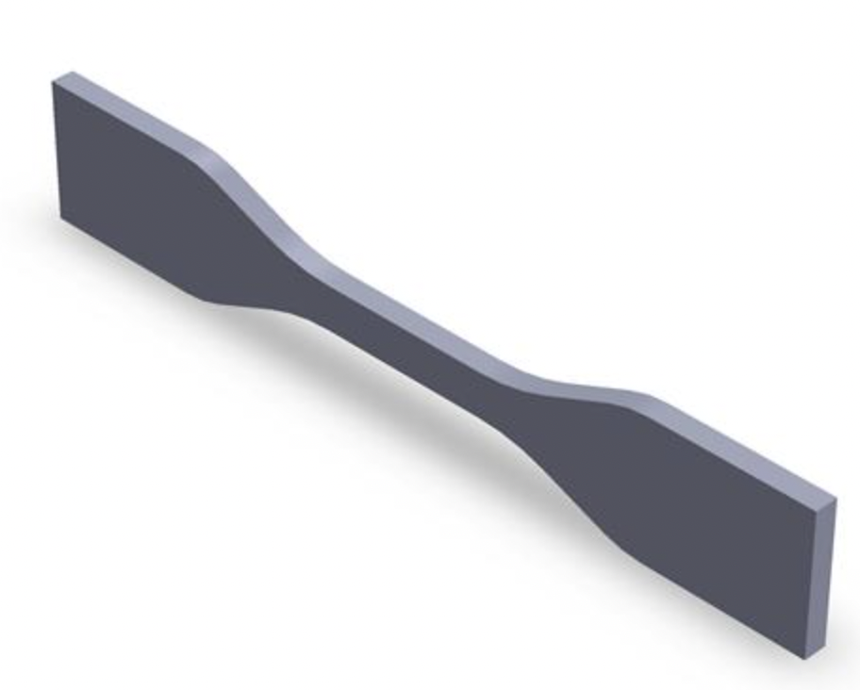
Creating, Printing, and Testing
Goal Date: mid February – mid April (2 months)
Action Items:
Extrude filament from fresh PET filament & regrind PET filament using extruder prototype
Compare material properties of filament
Dogbone sample for mechanical properties (Tensile Strength Test, Charpy Test)
Other shapes for morphological testing
3D Printing Efficacy
Visual comparison
Microscopy for surface defects
Financial Analysis
Total cost
Cost comparison
Dogbone print model
Notes:
–our plan is to use the machines in the material sciences lab
–we will communicate with dr. rogers about this collaboration

Slide 6
Rough Cost Estimate of Extruder
Item | Quantity | Cost
Screw | 1 | $500.00
Barrel | 1 | $300.00
Housing | 1 | $95.40
Hopper | 1 | $176.41
Gearbox | 1 | $547.37
Motor | 1 | $674.59
Cooling Fans | 3 | $22.97
Heater | 3 | $59.39
Temperature Probe | 3 | $43.52
PID Controllers | 3 | $188.04
Die | 1 | $650.00
Power Supply | 1 | $521.40
Total |  | $4,406.93

Slide 7
Questions/Potential Roadblocks
What is the budget?
Which pieces of equipment or materials should we get quotes for?
Where can we get quotes for them?
When should everything be done?
Are there any other material tests that we should conduct?

Slide 8

“A Picture Is A Good Idea”
Walt Disney

